Slide 1
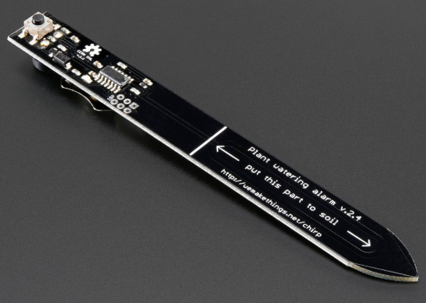
Chirp! Water sensor plant watering alarm
BY : DIVYA AGGARWAL

Slide 2
INTRODUCTION
Purpose:- Chirp! Water sensor is a plant watering alarm that helps to extend the life of plant by reminding person to water it.
Working:- This sensor not only beeps at lower level but also sense light using light sensor. The light sensor helps chirp to not let alarm make much noise when its dark.
My Team:- Tarundeep Kaur Sandhu and Jasleen Grewal

Slide 3

budget
Budget for my hardware project is same as I decided earlier.
I already bought my tool kit in 1st semester, so I don’t consider it this time in total budget.

Slide 4
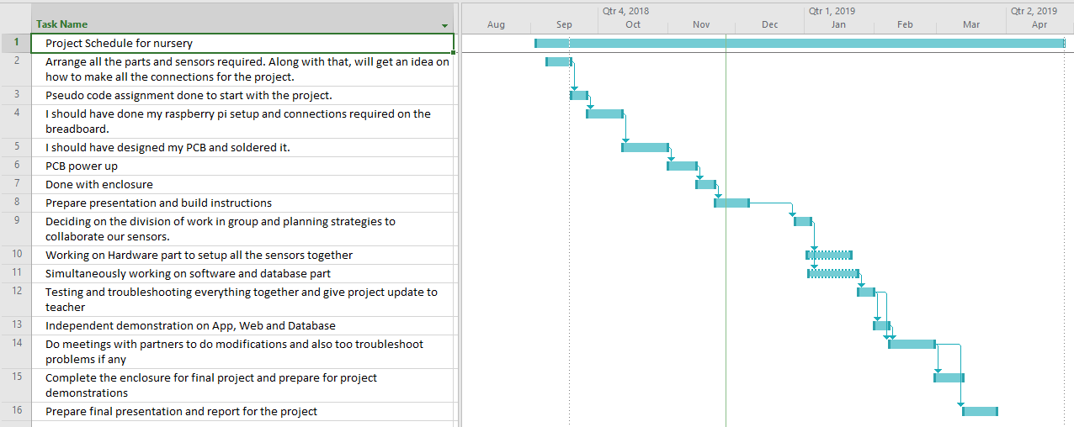
schedule
Project Schedule for nursery
Project Schedule for nursery

Slide 5
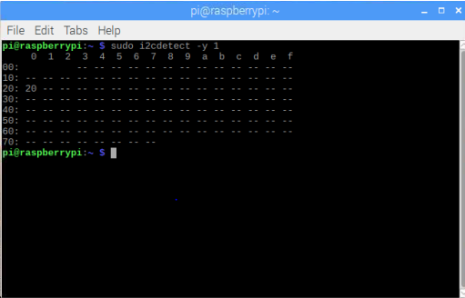
I2C ADDRESS

Slide 6
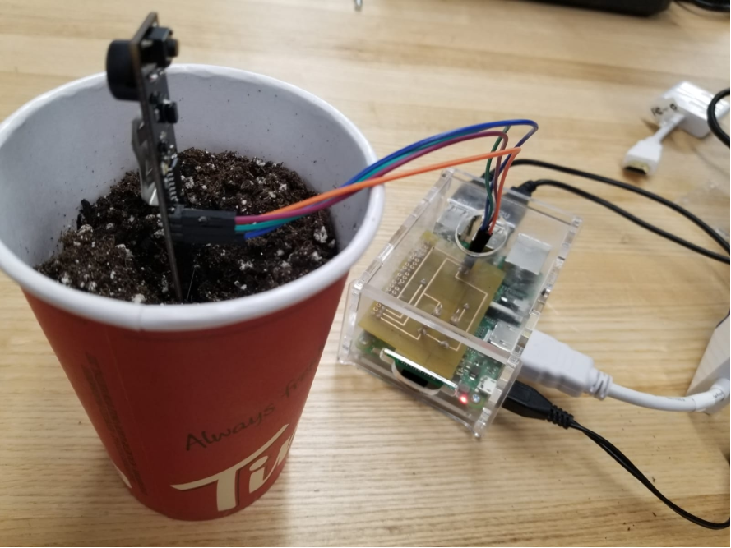
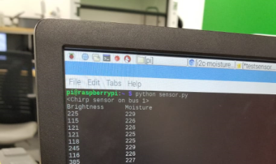
READINGS

Slide 7

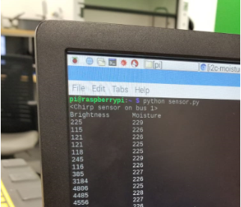
READINGS

Slide 8
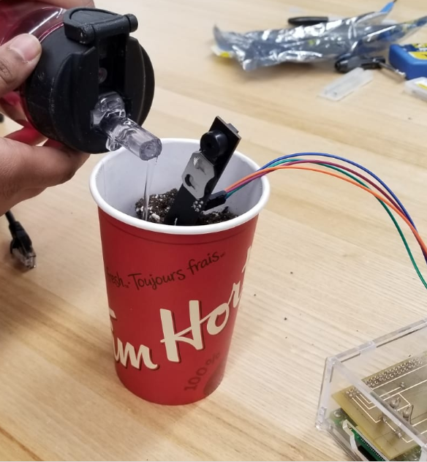
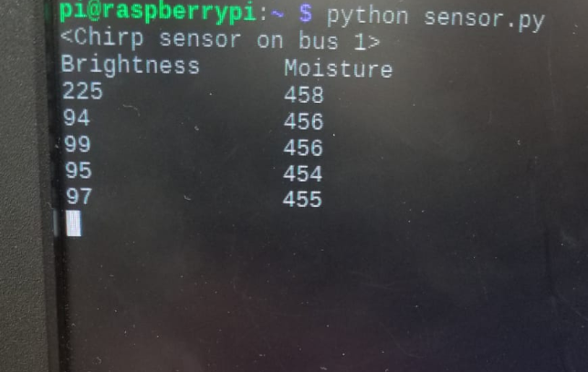
READINGS

Slide 9
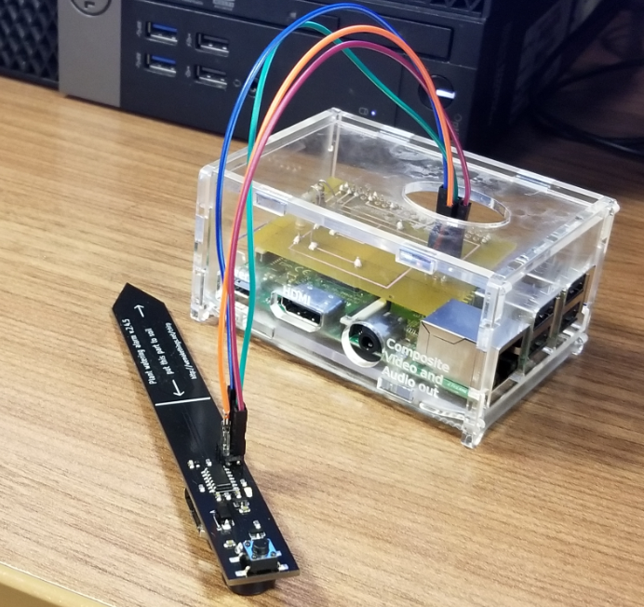
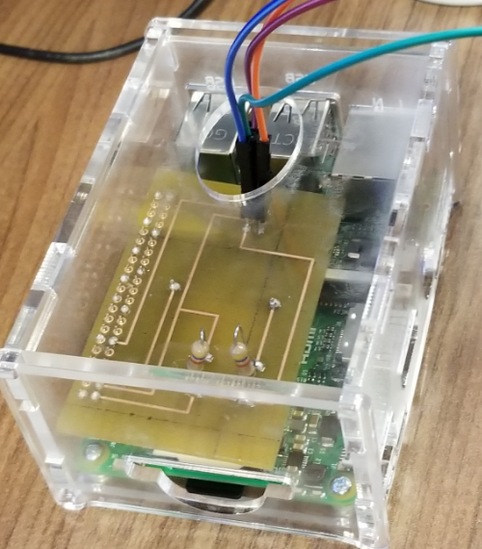
ENCLOSURE

Slide 10
Related courses
TECH 101:- We became familiar to Raspberry pi
TECH 153:- A great deal about raspberry pi was learnt in Paul Moggach’s course.
CENG216:-Made familiar to Gantt Chart , choose the project type
The prototype lab helped in soldering and to learn other functionalities of the pi.

Slide 11
THANKYOU

